Slide 1
R
Probability

Slide 2
help.search(“distribution”)
help(Distributions)

Slide 3
For every distribution there are four commands. The commands for each distribution are prepended with a letter to indicate the functionality
:
“d” | returns the height of the probability density function
“p” | returns the cumulative density function
“q” | returns the inverse cumulative density function (quantiles)
“r” | returns randomly generated numbers

Slide 4
p for "probability", the cumulative distribution function (c. d. f.)
q for "quantile", the inverse c. d. f.
d for "density", the density function (p. f. or p. d. f.)
r for "random", a random variable having the specified distribution
For a continuous distribution (like the normal), the most useful functions for doing problems involving probability calculations are the "p" and "q" functions (c. d. f. and inverse c. d. f.), because the the density (p. d. f.) calculated by the "d" function can only be used to calculate probabilities via integrals and R doesn't do integrals.
For a discrete distribution (like the binomial), the "d" function calculates the density (p. f.), which in this case is a probability
f(x) = P(X = x)and hence is useful in calculating probabilities.

Slide 5
Normal Distribution
Dnorm
The first function we look at it is dnorm. Given a set of values it returns the height of the probability distribution at each point. If you only give the points it assumes you want to use a mean of zero and standard deviation of one. There are options to use different values for the mean and standard deviation

Slide 6
dnorm(0)
dnorm(0)*sqrt(2*pi)
dnorm(0,mean=4)
dnorm(0,mean=4,sd=10)

Slide 7
v <- c(0,1,2) print(dnorm(v))
x <- seq(-20,20,by=.1) y <- dnorm(x) plot(x,y)
Note :Check Plot in / scripts folder - Rplots.pdf

Slide 8
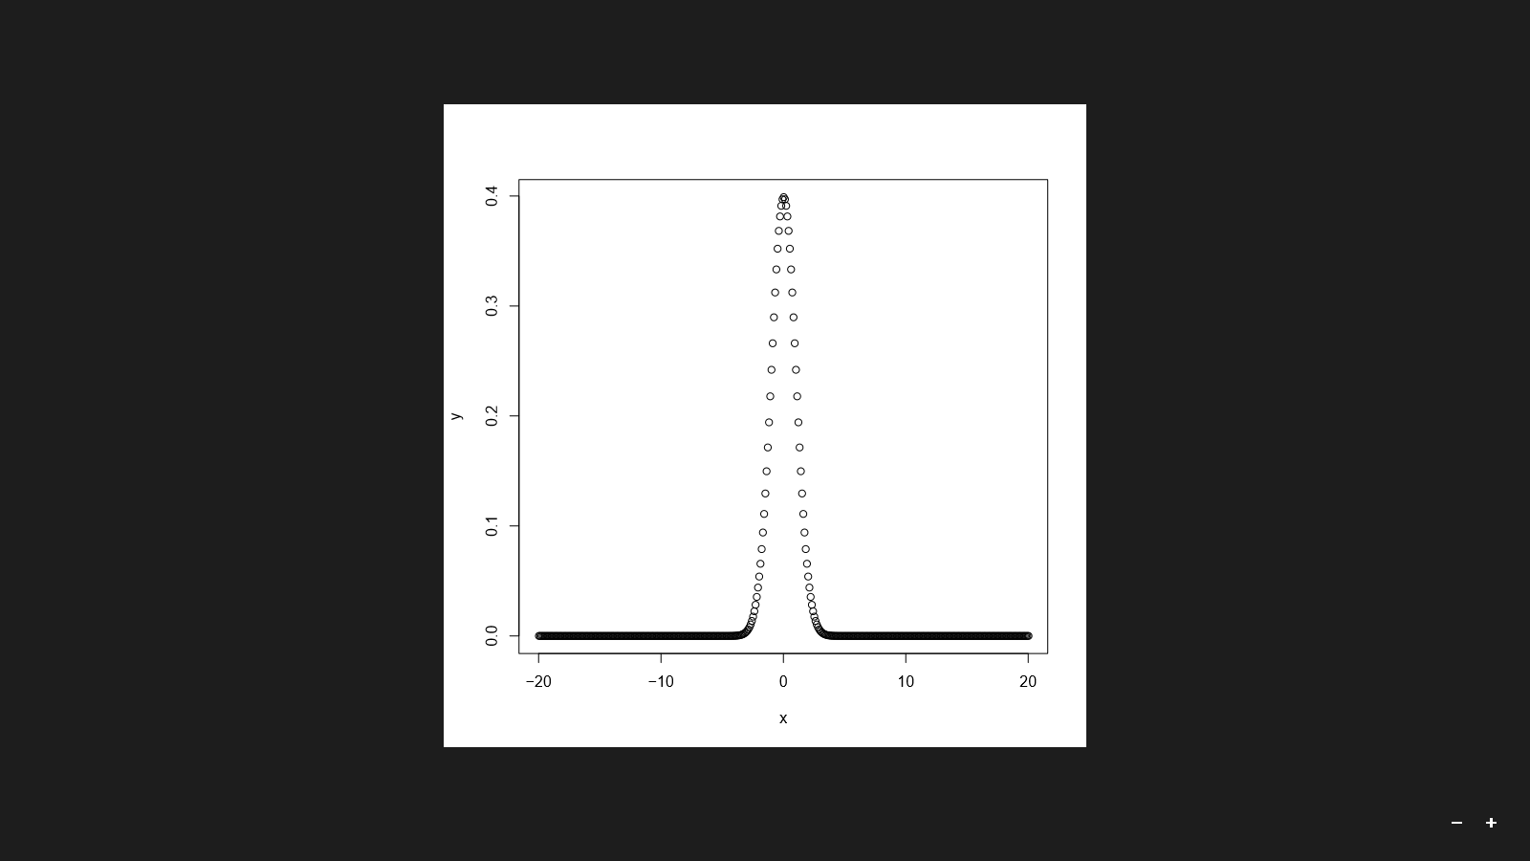
Plot

Slide 9
pnorm
Cumulative Distribution Function.
Instead of “d”, check with “q”
If you wish to find the probability that a number is larger than the given number you can use the lower.tail option:

Slide 10
qnorm
qnorm which is the inverse of pnorm
The idea behind qnorm is that you give it a probability, and it returns the number whose cumulative distribution matches the probability.

Slide 11
nans produced error in r
x <- seq(-20,20,by=.1) y <- qnorm(x,mean=3,sd=4, lower.tail=FALSE) plot(x,y)
crashed on the non-numeric argument – not a number
Only positive values of n are allowed into the loop

Slide 12
x <- seq(-20,20,by=.1) y <- pnorm(x,mean=3,sd=4, lower.tail=FALSE) z <- qnorm(y) plot(x,z)

Slide 13
PDF
pdf("plots.pdf")
pdf("plots.pdf", width=6, height=3)
pdf("plots.pdf")
plot(...)
plot(...)
dev.off()
# include title for readability

Slide 14
code
pdf("plots2.pdf")
v <- c(0,1,2)
print(dnorm(v))
x <- seq(-20,20,by=.1)
y <- pnorm(x,mean=3,sd=4, lower.tail=FALSE)
plot(x,y, main="P Norm Tail = FALSE")
y <- pnorm(x,mean=3,sd=4, lower.tail=TRUE)
z <- qnorm(y)
z <- qnorm(y)
plot(x,y, main="P Norm Tail = TRUE")
plot(x,z, main="Q Norm Fisrt sample")
x <- seq(0,1,by=.05)
y <- qnorm(x)
plot(x,y, main="Q Norm 2nd sample")
dev.off()

Slide 15
rnorm
which can generate random numbers whose distribution is normal.
r <- rnorm(4,mean=3,sd=3)
print(r)
hist(r)
#Check with histogram output

Slide 16
Problem:
Question: Suppose keyboard weights produced at Acme Widgit Works have weights that are normally distributed with mean 17.46 grams and variance 375.67 grams. What is the probability that a randomly chosen Keyboard weighs more then 19 grams?
Question Rephrased: What is P(X > 19) when X has the N(17.46, 375.67) distribution?
Caution: R wants the s. d. as the parameter, not the variance. We'll need to take a square root!

Slide 17
# What is P(X > 19) when X has the N(17.46, 375.67) distribution?
pvalue <- pnorm(19, mean=17.46, sd=sqrt(375.67))
print(paste("Pvalue", round(pvalue,3)))

Slide 18
Qnorm - Examle
Question: Suppose IQ scores are normally distributed with mean 100 and standard deviation 15. What is the 95th percentile of the distribution of IQ scores?
Question Rephrased: What is F⁻¹(0.95) when X has the N(100, 15²) distribution?
# What is F-1(0.95) when X has the N(100, 15^2) distribution?
qvalue <-qnorm(0.95, mean=100, sd=15)
print(paste("qvalue", round(qvalue,3)))

Slide 19
Rnorm for sample data
#rnorm
x <- rnorm(1000, mean=100, sd=15)
hist(x, probability=TRUE)
xx <- seq(min(x), max(x), length=100)
lines(xx, dnorm(xx, mean=100, sd=15))

Slide 20
t Distribution
Similar to Normal
help(TDist)
One difference is that the commands assume that the values are normalized to mean zero and standard deviation one, so you have to use a little algebra to use these functions in practice.

Slide 21
The other difference is that you have to specify the number of degrees of freedom. The commands follow the same kind of naming convention, and the names of the commands are dt, pt, qt, and rt.

Slide 22
Binomial Distribution
help(Binomial)
These commands work just like the commands for the normal distribution.
The binomial distribution requires two extra parameters, the number of trials and the probability of success for a single trial.
Dbinom,qbinom etc

Slide 23
x <- seq(0,100,by=1)
y <- dbinom(x,100,0.6)
plot(x,y)
Question: Suppose keyboard produced at Acme Widgit Works have probability 0.005 of being defective. Suppose keyboard are shipped in cartons containing 25 keyboards. What is the probability that a randomly chosen carton contains exactly one defective keyboard?
Question Rephrased: What is P(X = 1) when X has the Bin(25, 0.005) distribution?
Answer:
#What is P(X = 1) when X has the Bin(25, 0.005) distribution? z <- dbinom(1, 25, 0.005) print(paste("Binomial prob", round(z,3)))

Slide 24
Question
What is the probability that a randomly chosen carton contains no more than one defective widgit?
pbinom(1, 25, 0.005)

Slide 25
Chi-Squared Distribution
help(Chisquare)
The first difference is that it is assumed that you have normalized the value so no mean can be specified.
The other difference is that you have to specify the number of degrees of freedom.
dchisq, pchisq, qchisq, and rchisq.
qchisq(0.05,df=10)

Slide 26
Calculating p Values
t.test(x)
# finding P value x = c(9.0,9.5,9.6,10.2,11.6) print(t.test(x))
t.test(x,mu=10) # mu argument = mean
t.test(x,mu=10,alternative="less") # alternate H1
Analysis – in next slide

Slide 27
The t.test() command also accepts a second data set to compare two sets of samples
> x = c(9.0,9.5,9.6,10.2,11.6)
> y=c(9.9,8.7,9.8,10.5,8.9,8.3,9.8,9.0)
> t.test(x,y)

Slide 28
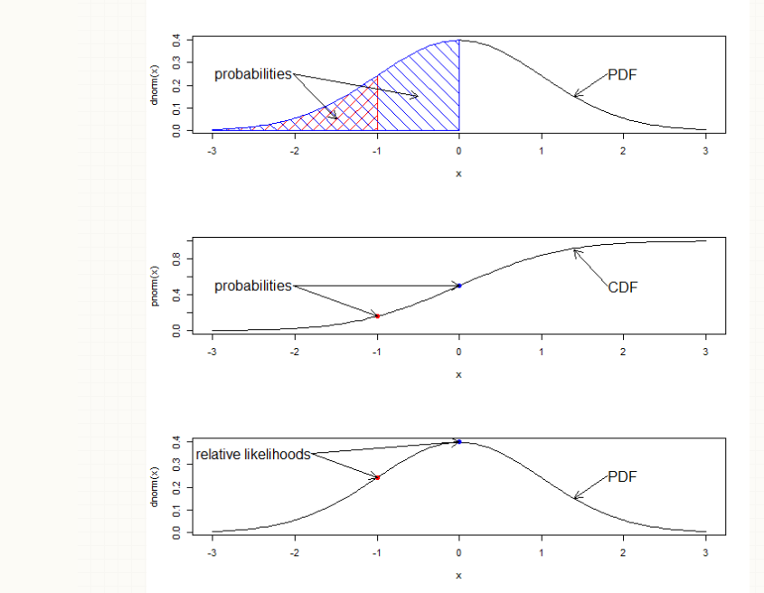

Slide 29
dnorm is density function and
pnorm is distribution function.

Slide 30
data: x
t = 22.294, df = 4, p-value = 2.397e-05
alternative hypothesis: true mean is not equal to 0
95 percent confidence interval:
8.737095 11.222905
sample estimates:
mean of x
9.98

